Slide 1
NE 591: Advanced Reactor Materials
Fall 2021
Dr. Benjamin Beeler

Slide 2
Last Time
Thermal conductivity degradation
fission gas swelling/porosity, sodium infiltration
Fuel-cladding mechanical interaction
fuel swelling, creep, internal pressure, etc.
Fuel-cladding chemical interaction
phase diagrams and kinetics, low melting points, intermetallics, etc.

Slide 3
FCCI
The burnup of a fuel pin is another parameter that impacts the size of the fuel–cladding interaction zone
Larger interaction zones are observed for higher burnup fuel elements
The larger inventories of fission products allow more lanthanides to diffuse down the temperature gradient, thereby increasing the inventory of fission products at the interface
For high burnup fuels, temperature effects also exacerbate FCCI due to thermal cond. degradation producing higher temperatures, and more rapid FP diffusion
Fuel elements at the hotter core positions can exhibit increased interdiffusion at the fuel–cladding interface over those at colder positions

Slide 4
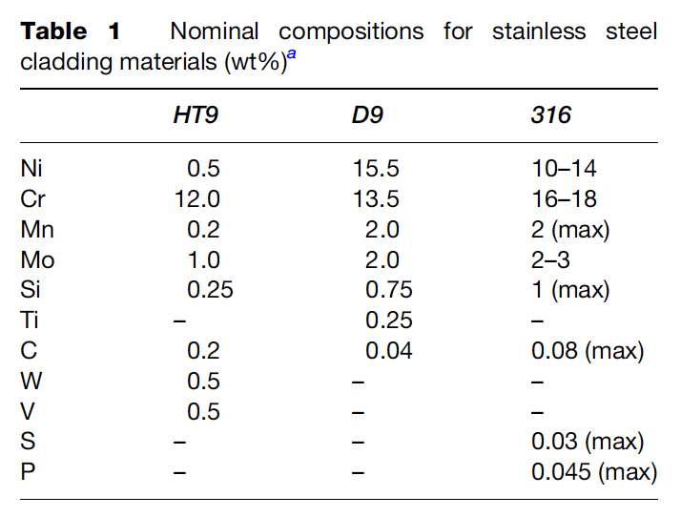
FCCI Compositions
Fe and Cr are the major constituents in HT-9 cladding and should show up as major constituents in the FCCI zones of irradiated HT-9-clad fuel elements
For D9-clad fuel elements, Fe, Ni, and Cr are major constituents that should be present in FCCI zones
There have been some irradiated fuel samples that were specifically destructively analyzed to observe FCCI
The lowest and highest determined temperatures at the fuel–cladding interface were 540 and 660 C, respectively
The thickest interaction zone measured was 170 μm, and the lanthanide fission products were the primary fuel constituents observed in the interaction layers

Slide 5
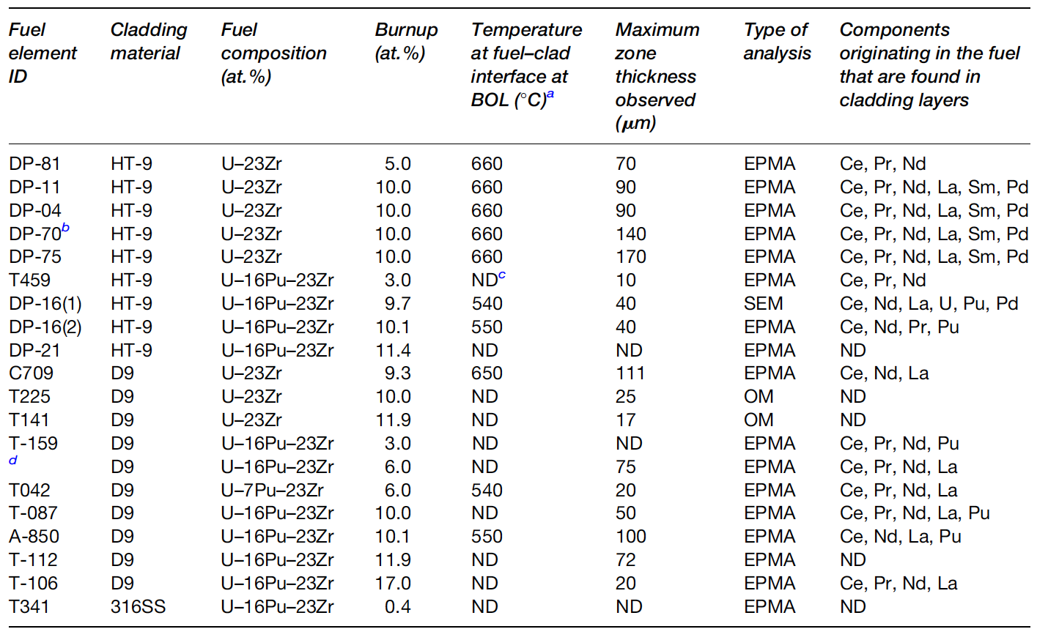
FCCI Examinations

Slide 6
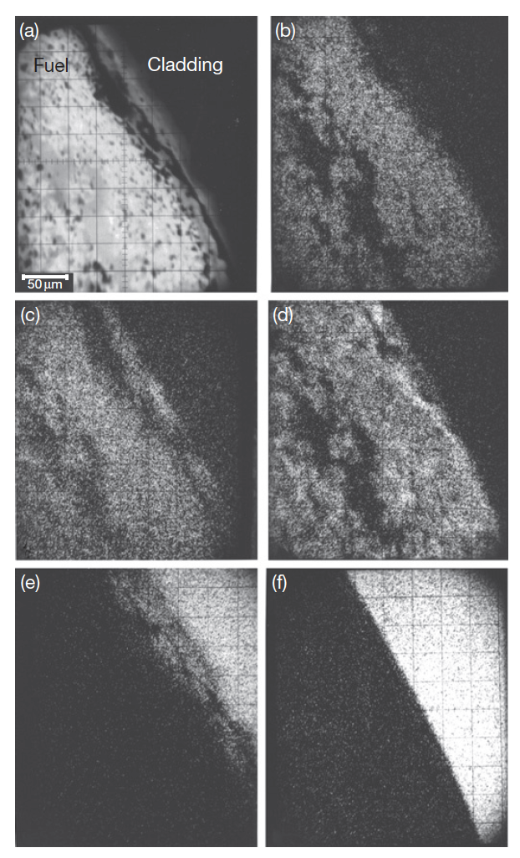
FCCI Compositions
Element DP-16 was the only fuel element in which a sample was generated for analysis using SEM/EDS, in addition to the more typical OM and EPMA analyses usually performed on fuel elements
U-16Pu-23Zr and HT-9 cladding
X-ray analysis maps at the right
(b) U, (c) Pu, (d) Zr, (e) Fe, (f) Cr

Slide 7
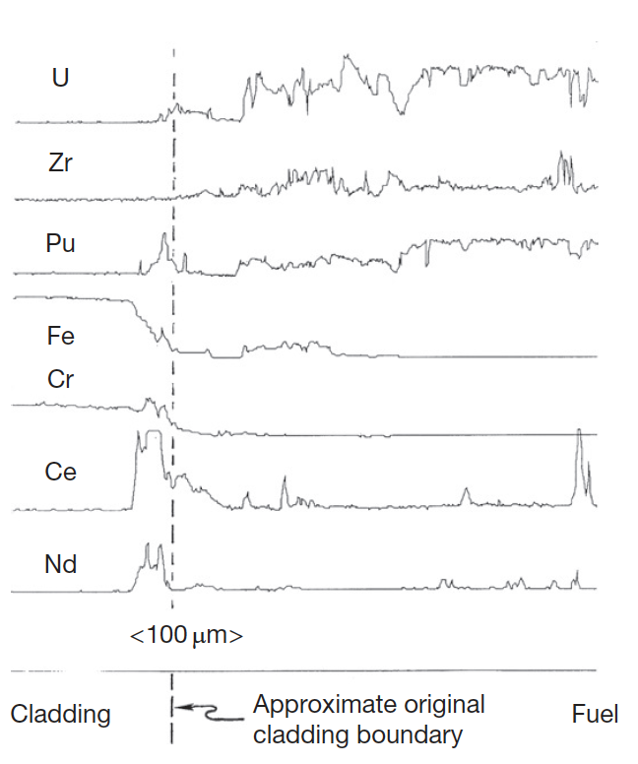
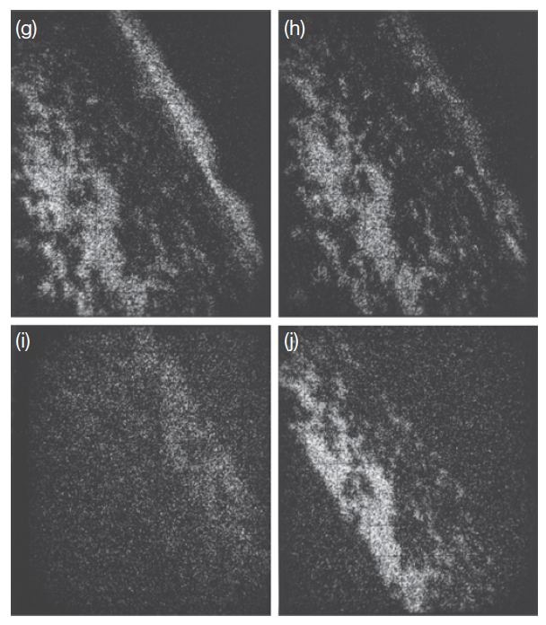
FCCI Compositions
X-ray map for fission products
EPMA analysis for key species
Fe diffuses into the fuel, Ce and Nd diffuse into the cladding, and Pd enriches in localized areas of the fuel near the fuel–cladding interface
The lanthanides penetrated the farthest into the cladding (40 mm) of any components originating in the fuel
(g) Ce, (h) Nd, (i) Ru, and (j) Pd

Slide 8
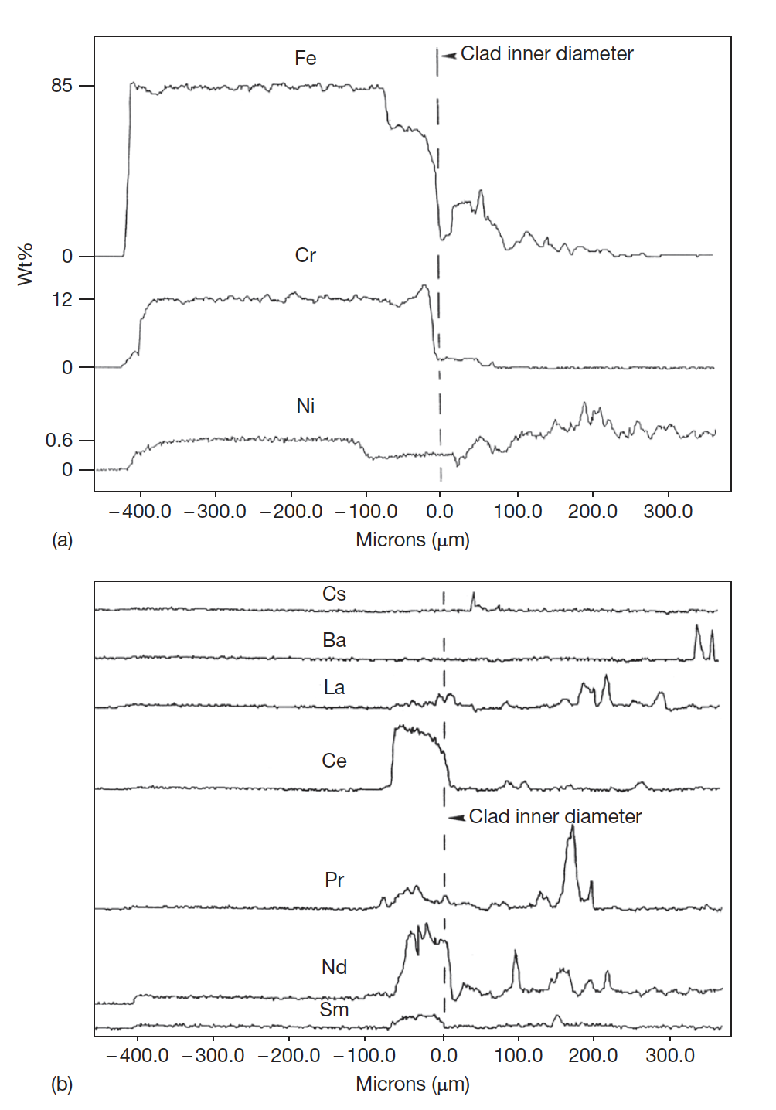
FCCI Compositions
The DP-11 fuel element was irradiated to about 10 at.% burnup at elevated cladding temperatures (630–660 C), binary U-Zr
There is a 50-μm-wide zone of the cladding that is high in Cr and low in Fe and Ni
In the fuel, Fe has interdiffused around 250 μm
In the cladding band containing high Cr and low Fe and Ni, lanthanide concentrations are elevated

Slide 9
FCCI
A variety of phases have been observed to form locally where swelled fuel has contacted the cladding
At the interface between the fuel and the cladding, the observed phases on both sides combine the cladding elements Fe, Ni, and Cr with the fuel components U, Zr, and Pu and the lanthanide fission products
In the cladding, the developed phases are enriched with cladding components, and they contain differing amounts of the primary fuel components and fission product components
Lanthanides penetrate farthest into the cladding, specifically Ce and Nd
Fe and Ni depletion zones are observed in all the fuel elements

Slide 10
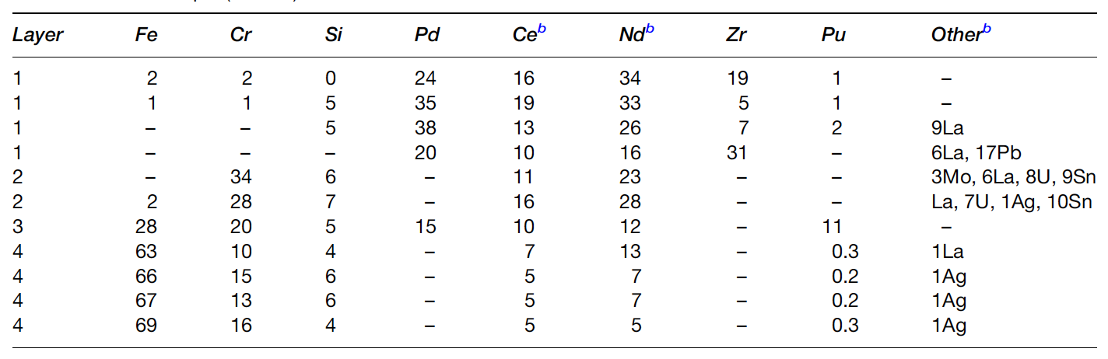
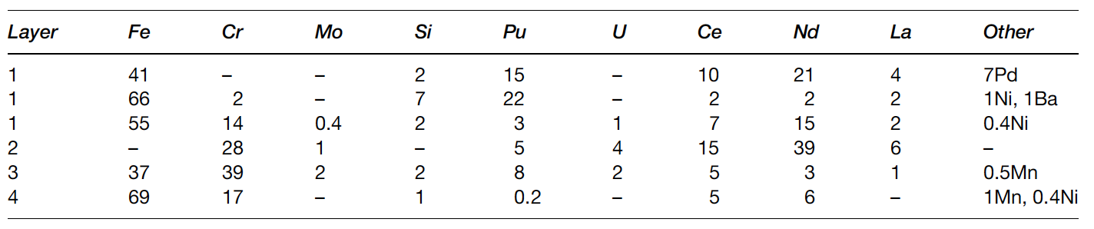
FCCI
In the fuel, some phases are observed that are enriched with the fuel constituents and contain Fe or Ni as the major nonfuel or components
Other phases are observed that primarily contain lanthanides
The interaction zone formation is localized
Temperature and power variations along the length of a fuel element appear to impact the amount of FCCI that occurs
Two different locations in DP-16

Slide 11
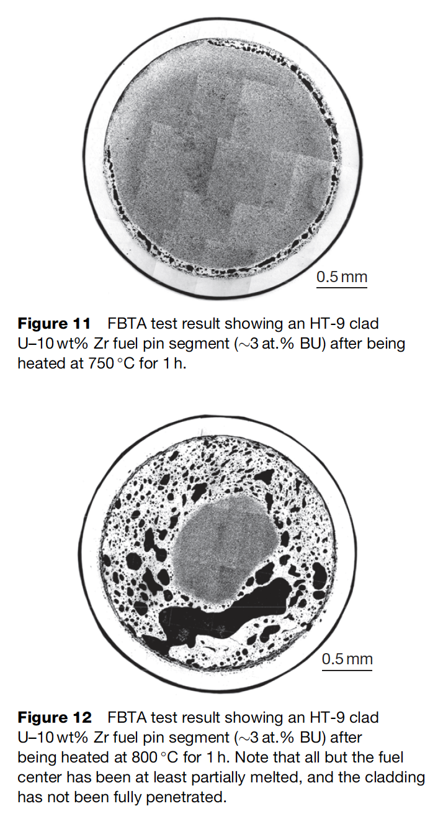
Melting Experiments
One potentially significant impact that the presence of FCCI zones is the melting of phases inside the cladding
This will limit the allowable coolant temperature that can be used for the reactor, but it can become more important when considering transients and accidents
This illustrates the effect of the relatively low quantities of Fe required to cause melting on the uranium-rich side of the U–Fe phase diagram
In general, no liquid phase formation is observed below heating at 700C

Slide 12
Metal fuel fabrication

Slide 13
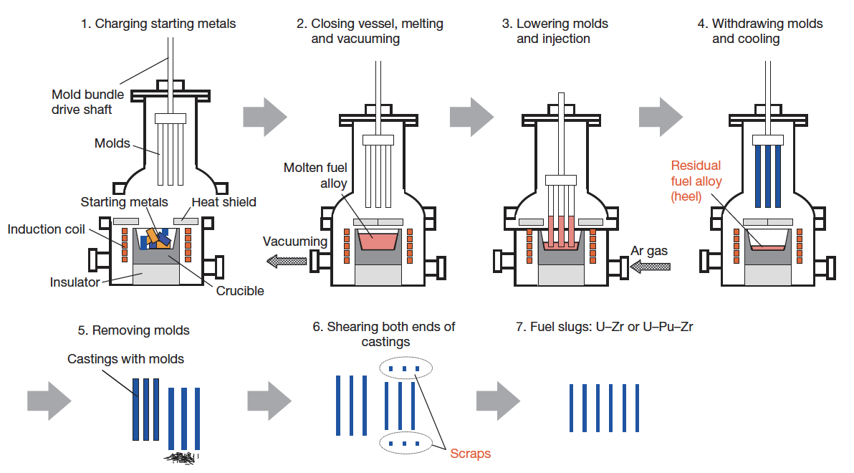
Metal Fuel Fabrication
Injection casting has been utilized for fuel slug fabrication
Remote fabrication has been performed inside a hot cell on recovered uranium
Fuel slugs for EBR II and FFTF were fabrication via injection casting

Slide 14
Metal Fuel Fabrication
Starting materials are charged into the graphite crucible in the furnace
Silica molds with tops closed are set above the crucible
Crucible is coated with yttria
Molds coated with zirconia

Slide 15
Metal Fuel Fabrication
Furnace closed and filled with Ar gas
Crucible is inductively heated to 1830K, and stirred electromagnetically
Ar gas removed, molds are lowered, then Ar gas returned
Pressure difference injects the melt into the molds

Slide 16
Questions?

